Slide 1
Advanced Tools and Scripting with PowerShell 3.0
Jeffrey Snover | Distinguished Engineer & Lead Architect
Jason Helmick | Senior Technologist, Concentrated Technology

Slide 2

Meet Jeffrey Snover | ‏@jsnover
Distinguished Engineer & Lead Architect for Windows Server & System Center Division
Inventor of Windows PowerShell
Responsible for setting long term technical vision for these products and running the technology planning for the releases
Over 30 years of industry experience
Microsoft, Tivoli, NetView, DEC
Held 8 patents prior to joining Microsoft, and has registered 30 since.
Frequent speaker at industry and research conferences on a variety of management and language topics

Slide 3

Meet Jason Helmick | ‏@theJasonHelmick
Senior Technologist, Concentrated Technology
Board member and CFO – PowerShell.Org
Author “Learn Windows IIS in a Month of Lunches”
Contributing author “PowerShell Deep Dives”
25 year IT veteran
Speaker at a variety of industry conferences
Teaches PowerShell for the IT pro to maximize management and automation
Frequent contributor to TechNet Magazine and other industry publications

Slide 4


Course Topics
Scripting and Toolmaking
01 | Get started scripting | 06 | Writing help
02 | PowerShell’s scripting language | 07 | Error handling
03 | Simple scripts and functions | 08 | Tools that make changes
04 | Advanced functions | 09 | Script and Manifest modules
05 | More on parameters

Slide 5
Setting Expectations
Target Audience
Tailored for the IT pro that needs to improve management and automation
Fast paced for the real world
Suggested Prerequisites/Supporting Material
Experience working as a Windows IT pro/Admin/Help Desk
Get answers in the forums at PowerShell.Org
Coming Soon – Microsoft Marketplace course 55038 Windows PowerShell Scripting and Toolmaking
Check out “Learn PowerShell Toolmaking in a Month of Lunches” by Don Jones and Jeffery Hicks

Slide 6

Join the MVA Community!
Microsoft Virtual Academy
Free online learning tailored for IT Pros and Developers
Over 1M registered users
Up-to-date, relevant training on variety of Microsoft products
“Earn while you learn!”
Get 50 MVA Points for this event!
Visit http://aka.ms/MVA-Voucher
Enter this code: AdvPowerShell (expires 9/2/2013)

Slide 7
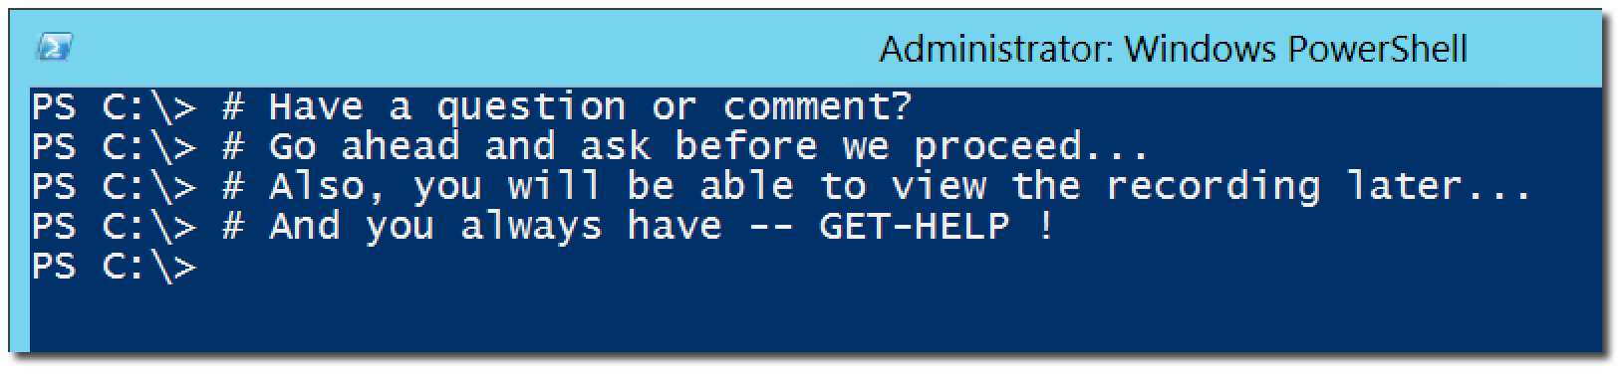
Questions or comments?

Slide 8
01 | Get started scripting
Jeffrey Snover | Distinguished Engineer & Lead Architect
Jason Helmick | Senior Technologist, Concentrated Technology

Slide 9
Module Overview
The purpose for PowerShell
Installing PowerShell – Windows Management Framework
Launching PowerShell for the administrator
PowerShell security goals
Execution Policy
Running Scripts
PowerShell ISE overview

Slide 10



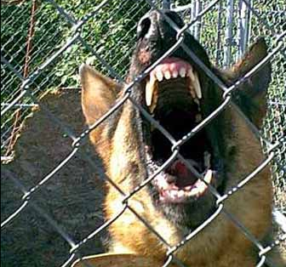
The Purpose to PowerShell
YOU
THEM
YOU
YOU
YOU
Improved management and automation
Manage real-time
Manage large scale

Slide 11
Installing PowerShell – Windows Management Framework
PowerShell V3 – Windows 8 and Server 2012
PowerShell V3 – Windows 7 SP1 and Server 2008 SP2 or Server 2008 R2 SP1
Download the Windows Management Framework 3.0 at
http://www.microsoft.com/en-us/download/details.aspx?id=34595
Read the instructions – you need the Full .NET 4.0 framework
Windows XP and Server 2003 can run V2

Slide 12
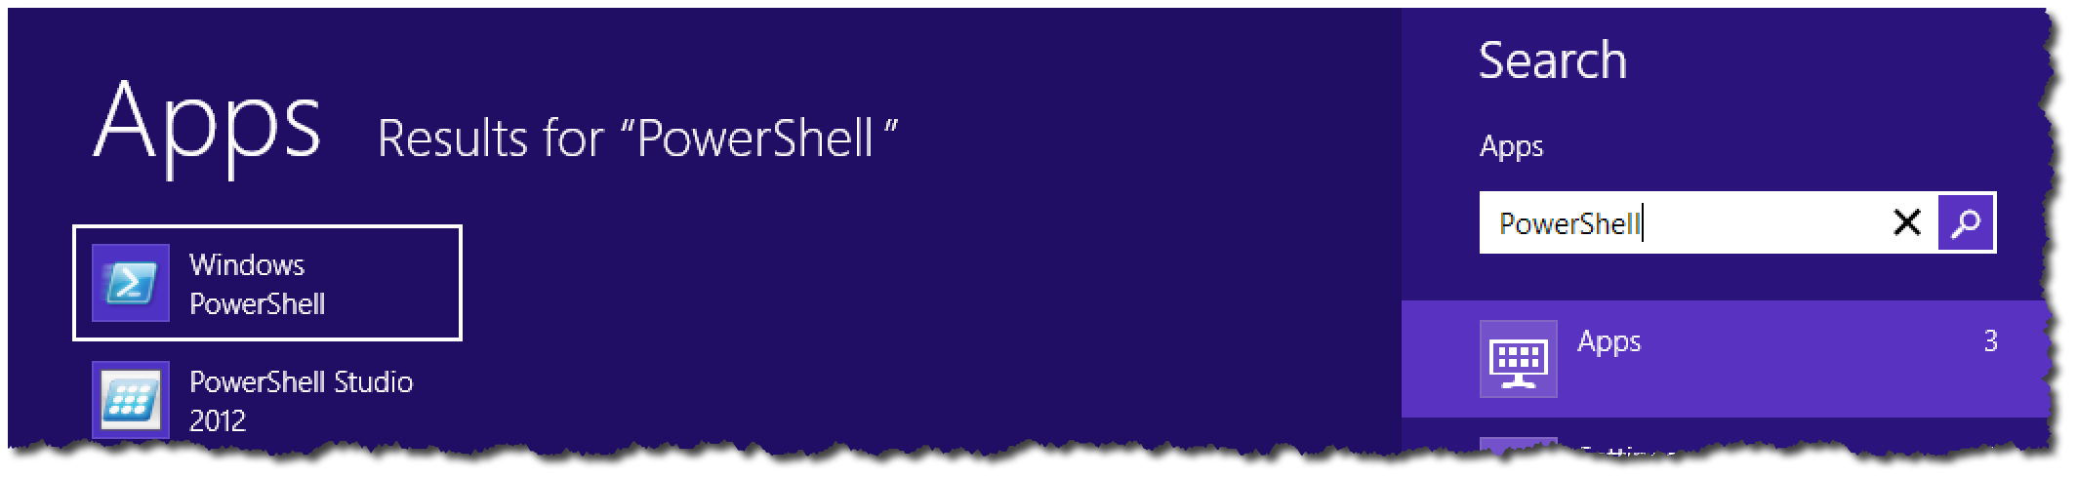

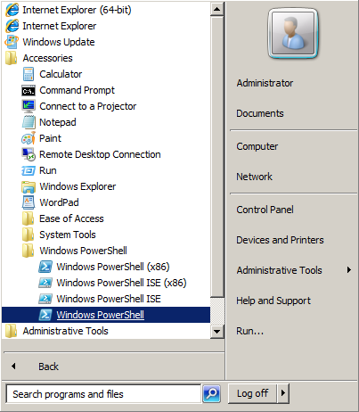
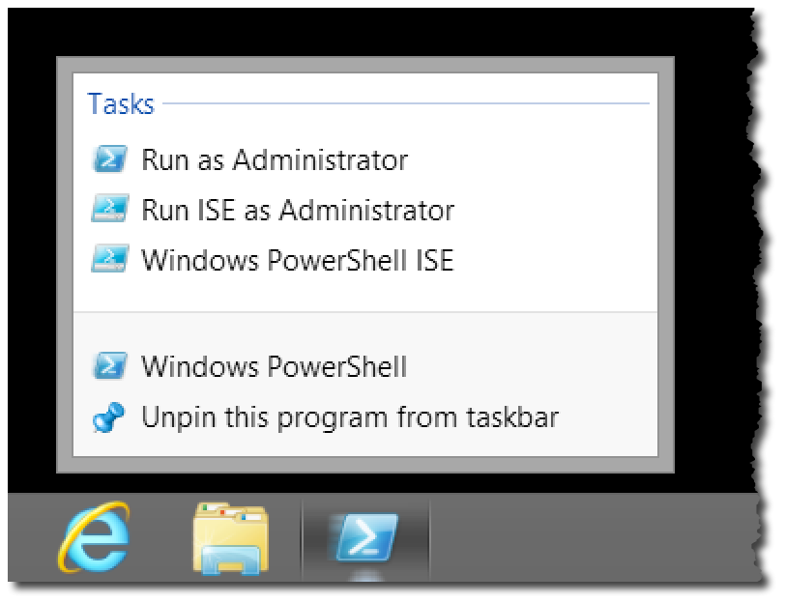
Launching PowerShell for the Administrator

Slide 13


PowerShell security goals
Secured by default
Prevents mistakes by unintentional admins and users
No Script Execution
.Ps1 associated with notepad
Must type path to execute a script

Slide 14

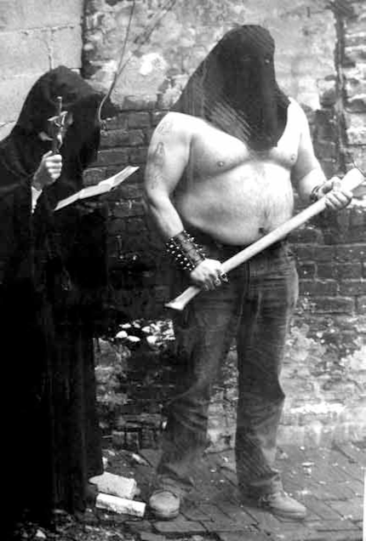
Execution Policy
By default, PowerShell does not run scripts.
Get/Set-ExecutionPolicy
Restricted
Unrestricted
AllSigned
RemoteSigned
Bypass
Undefined
Can be set with Group Policy

Slide 15
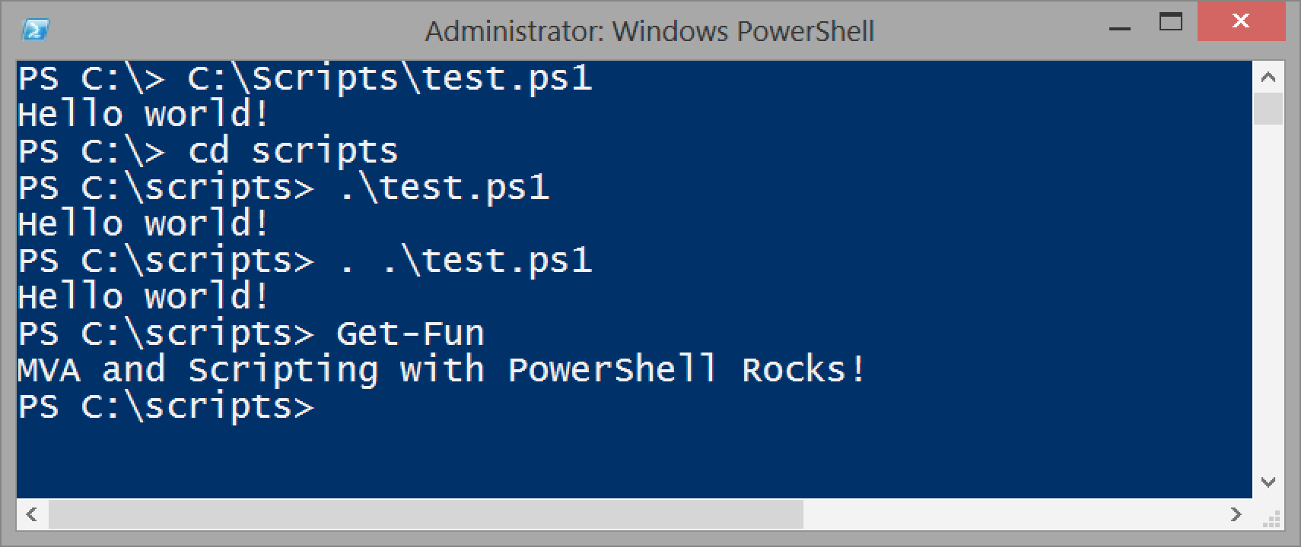
Running scripts

Slide 16
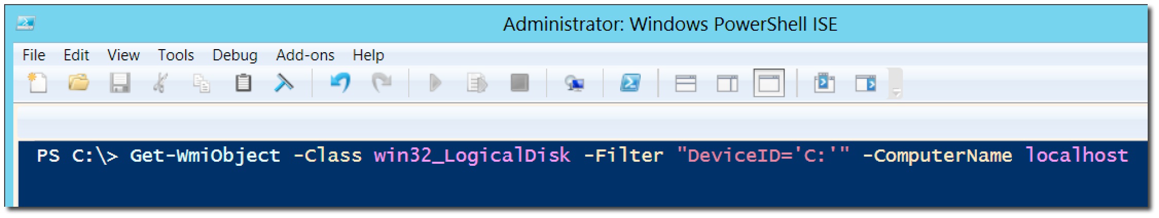
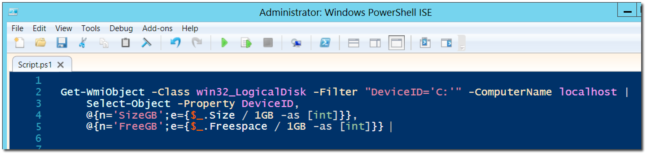
The new ISE

Slide 17
Questions or comments?

